Slide 1

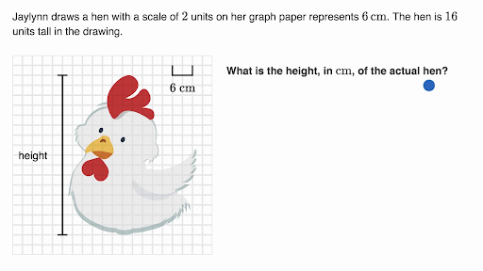
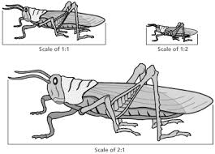

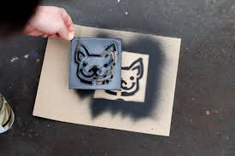
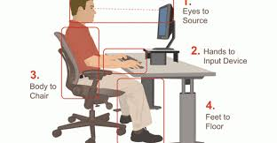
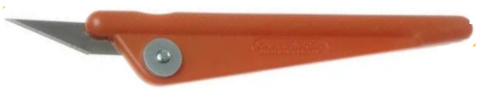
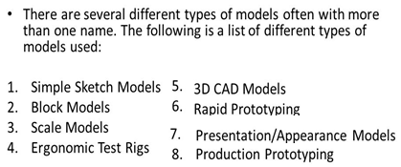
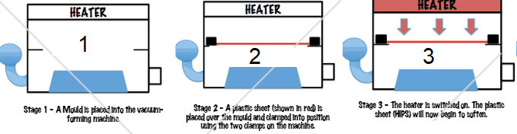

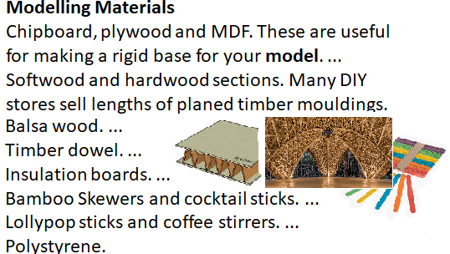
Year 7 Knowledge
Organiser
Vacuum Puzzle
SUCCESS CRITERIA
SCALE DRAWING
AESTHETICS
AND
DESIGN
CROWD FUNDING
SAFE USE
OF TOOLS
ERGONOMICS
TYPES OF MODELS
STENCIL
MODELLING MATERIALS
RISK
HAZZARD

