Slide 1
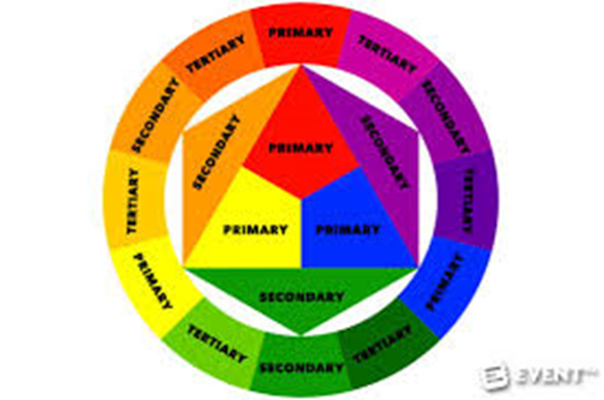
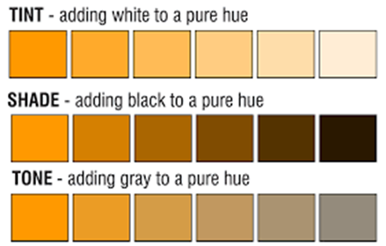
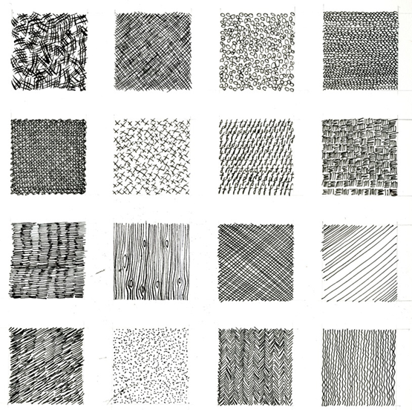
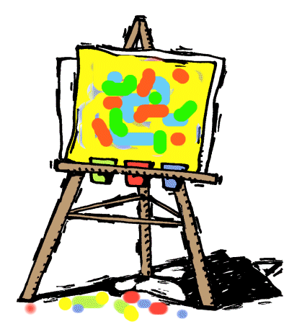
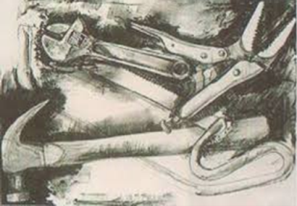
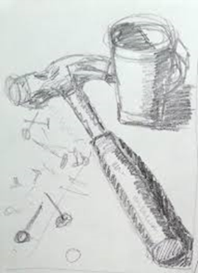
Knowledge Organiser - Colour Theory & Mark Making
In art, tone refers to the degree of lightness or darkness of an area.
Tone varies from light, medium and dark.
.
Key Words
Figurative
Still Life
Landscape
Tone
Colour
Cross hatch
Observational drawing is to observe
( look closely at an object or view and draw what we can see ).

Slide 2
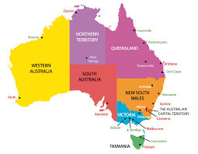
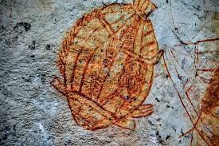
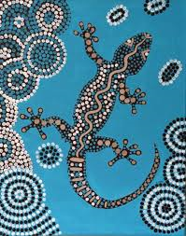
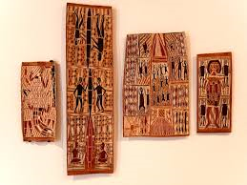
Knowledge Organiser - Year 7 Aboriginal Art
Australian Aboriginal Art
The Aborigines have occupied Australia for at least 50 thousand years. They have one of the oldest living art traditions in the world .
The art that the Aborigines show in their paintings often refers to the “The Dreaming's” the myths and stories of their ancestors.
Skills - Observational Drawing , Painting with powder paints, Colour Theory , Mark Making
Aboriginal paintings depict stories and myths about their ancestors and the creation of their land
Animals are often drawn with their skeleton and inner organs showing. Crosshatching and dotting are added for decoration.
The Aborigines used to paint on the walls of rock shelters or on tree bark using natural materials as paint.
One characteristic of Aboriginal paintings is simplistic images drawn from above.
Word Bank
Paint Composition Aboriginal Colour Design Symbols Technique

Slide 3
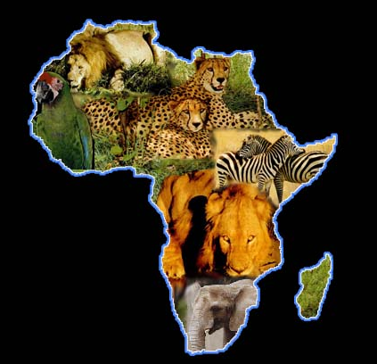
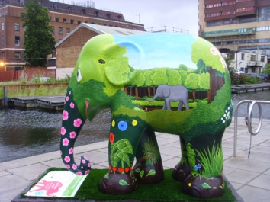
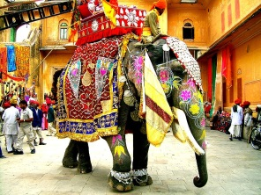
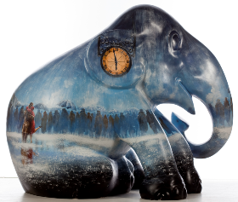
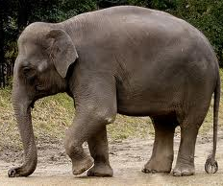
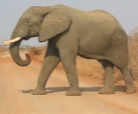
Knowledge Organiser -Elephant Parade Project
INCORPORATE
To add or include within your work
ORIGINAL
A new fresh or inventive idea
TONE
Refers to the lightness or darkness of an object
BLEND
To add one colour to another colour
MEDIA
The type of material used by the artist to create their artwork.
Elephant Family has been campaigning for the conservation of the endangered Asian elephant since 2002, and is the only UK charity dedicated solely and exclusively to saving the Asian elephant from extinction in the wild. The mission of Elephant Parade is to become the world's largest financial support organization for Asian elephants. This new project aims to raise public awareness, gather signatures for a government petition, and raise vital funds for conservation projects in Asia.
Endangered Species Act (ESA): The African elephant is listed as threatened. The Asian elephant is listed as endangered.
INNOVATIVE
To introduce something new or different
IMAGINATIVE
Showing how you have used your mind to create new ideas or images
NEGATIVE SPACE
The space around and between the subject(s) of an image.
Word Bank
Hunted
Ivory
Habitat loss – deforestation
Poaching
Medicine
Food
Skills – Drawing from imagination – painting and applying mixed media

