Slide 1
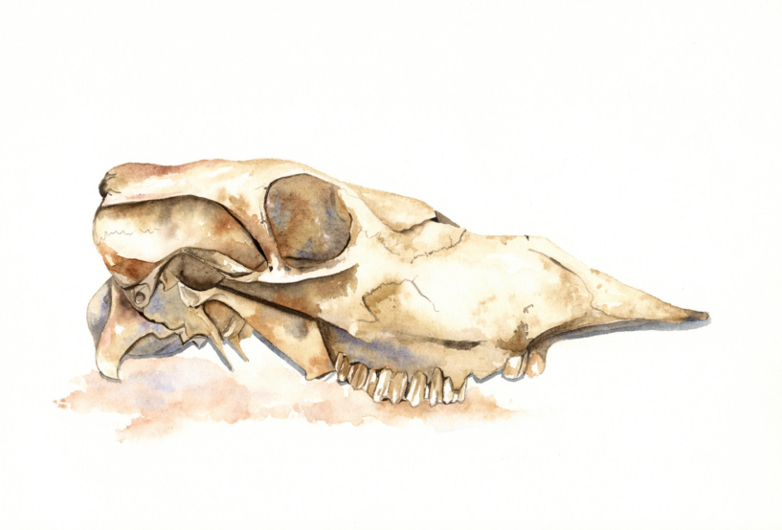
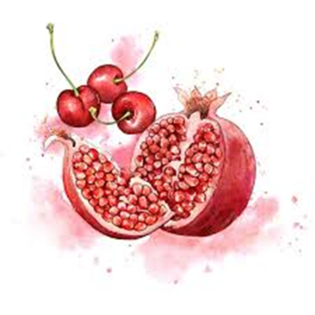
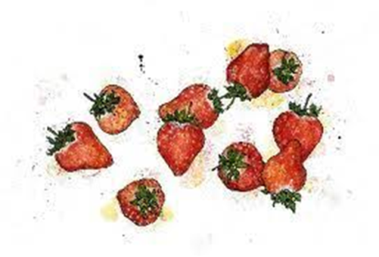
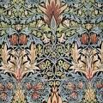
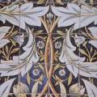
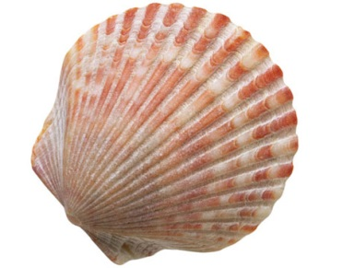
Knowledge organiser Natural Forms
When writing about your own work, ask yourself the following questions:
What have I done? Is it a painting a drawing or a sculpture? Your own
design or a copy?
How have I done it? Try to describe how you built up your work stage by stage.
Why have I done it/ what have I learnt through doing it? About an
artist? New skills?
What medium or materials have I used? Paint, pencil, collage, mixed
media etc.
What have I done well? Try to list at least 3 points.
What could I improve or what would I change if I were to do it
again?
Word Bank
Symmetry
Reflection
Diversity
Contemporary
Gouache
Lino tile
Inspiration
Emma Dibben My work is always inspired by the natural world and many of my illustrations begin as tiny seeds on my plot.
William Morris founded the Arts and Crafts Movement in Britain and designed some of the most recognisable textile s

Slide 2
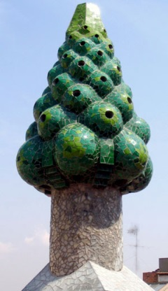
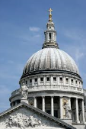
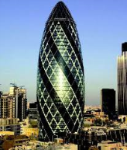
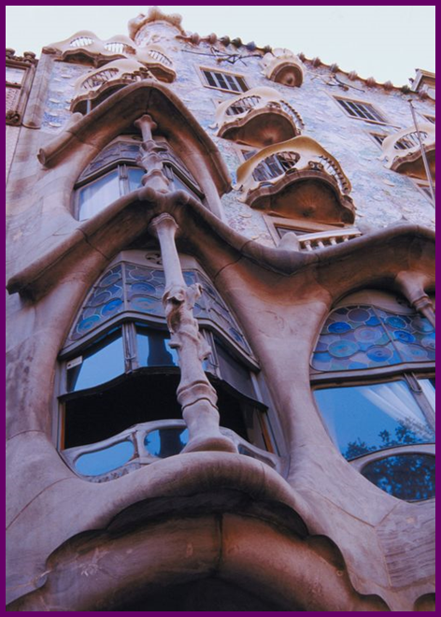
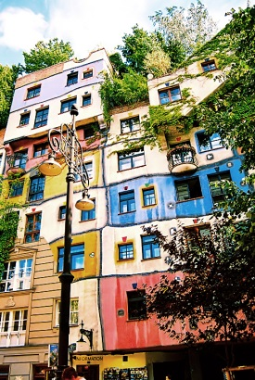
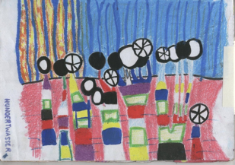
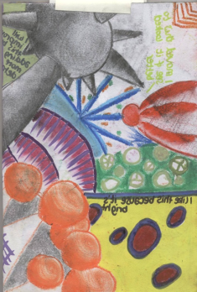
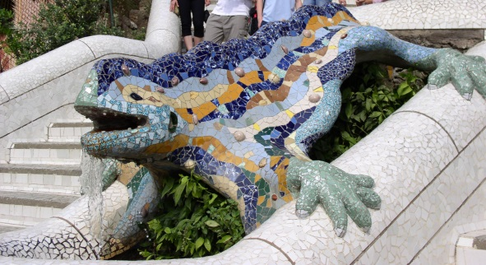
Knowledge Organiser Townscapes
Gaudi’s architecture was often highly irregular and very intricate.
Gaudi took inspiration from natural forms. He avoided using straight lines, giving his work an organic feel.
HUNDERTWASSER
Hundertwasser work was made up of organic shapes and spirals based on his love of nature and inspired by the artist Gustav Klimt
Gaudi has influenced many other architects, including the Austrian designer Friedensreich Hundertwasser.
Word Bank - Organic Natural Colourful Innovative Intricate Unusual Creativity Develop Refine Respond Analyse Evaluate Annotation

