Slide 1
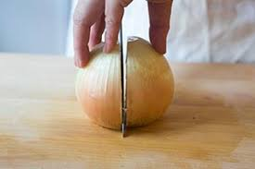
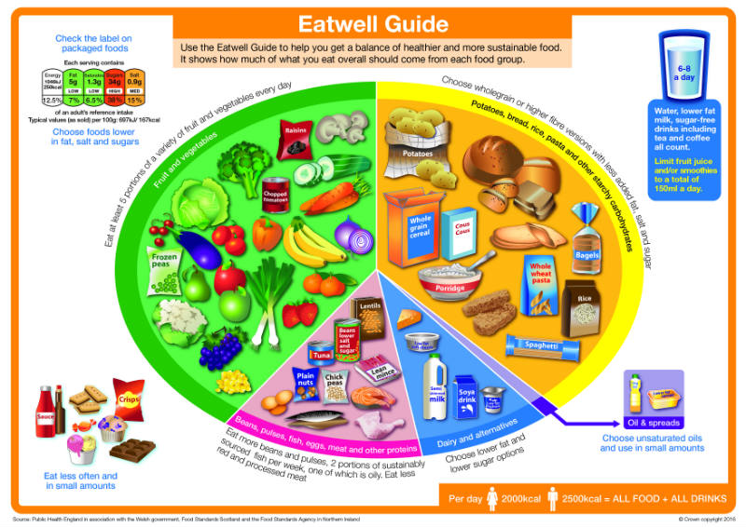
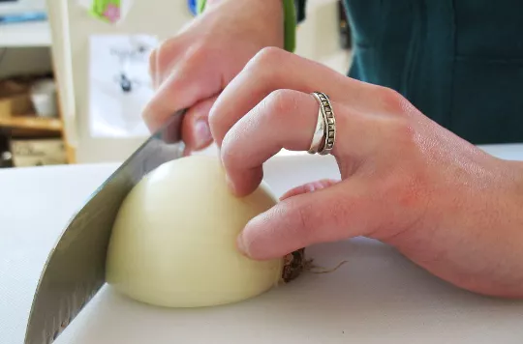
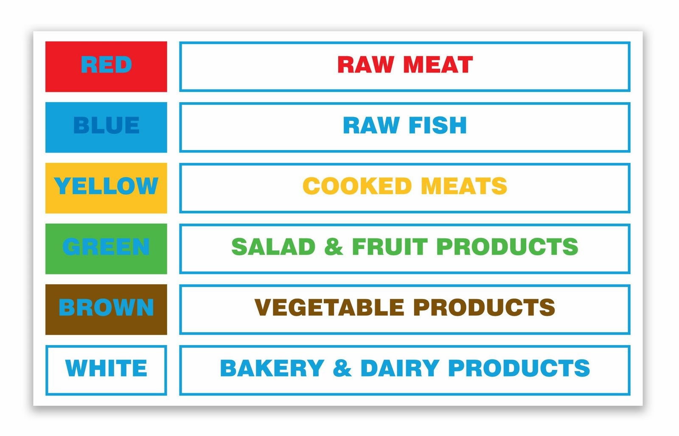
Year 8 knowledge organiser
The 4c’s
Composite meal: A composite meal is a meal made up of lots of different food types such as lasagne or shepherds pie
Preparation skills
Weighing and measuring
Rubbing in
Chopping
Shaping
Whisking
Enrobing
Kneading
folding
Cooking skills
Boiling
Baking
Shallow frying
Simmering
Blind baking
Cleaning, cross-contamination, cooking, cooling
Using bridge and claw to cut safely
Aeration: incorporating air into a mixture by whisking, folding or creaming
Enrobing: to coat
Coagulation: the action or process of a liquid, changing to a solid or semi-solid state.
Daily reference intakes for adults are:
Energy: 8,400kJ/2,000kcal
Total fat: less than 70g
Saturates: less than 20g
Carbohydrate: at least 260g
Total sugars: 90g
Protein: 50g
Salt: less than 6g

